Slide 1
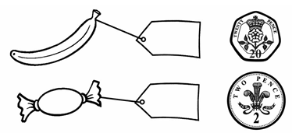

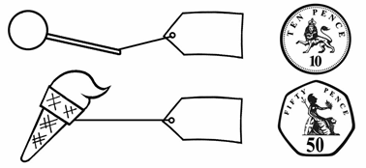

Key Learning: To recognise and compare the value of coins
Fill in the price labels. Use the signs <, > or = to fill in the circles.
>
>
Y2 U10 L1 Task

