Slide 2
Learning Objective
Use commas:
To separate items in a list
To separate extra information in a sentence
Between clauses
To show direct speech after a clause
After fronted adverbials

Slide 3
Recap
Commas tell the reader to make a brief pause, not as long as the pause for a full stop.
They are a little bit more complicated than other punctuation marks because they have lots of uses.

Slide 4

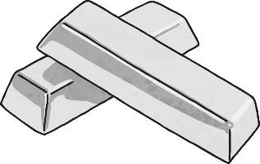



Starter
The antiques shop sells silver, paper, lanterns, drawers and vases.
Can you make this sentence mean different things using commas?

Slide 5








Version 1
The antiques shop sells silver, paper, lanterns, drawers and vases.
The commas like this show there are 5 items.
Version 2 – without the comma after silver
The antiques shop sells silver paper, lanterns, drawers and vases.
Without one of the commas, silver becomes an adjective to describe the paper, so there are now 4 items.

Slide 6

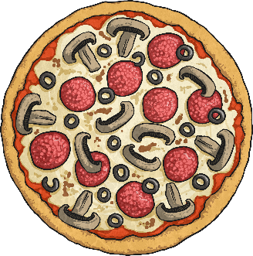
Introduction
Commas are used to separate items in lists, but ‘and’ is used instead of a comma for the last item.
In my fruit bowl, I have bananas, satsumas and kiwis.
Can you punctuate this list with commas?
,
My three favourite foods are fish pie stir fry and pizza.

Slide 7


Introduction
Commas can be used like brackets to separate extra information from the main sentence. These are sometimes called embedded clauses.
The boy, who was only eight, won the award for best actor.
Notice that the sentence still makes sense if you don’t include the clause inside the commas.
Can you separate the extra information in this sentence?
,
,
The sandwich which was the only one left was delicious.

Slide 8
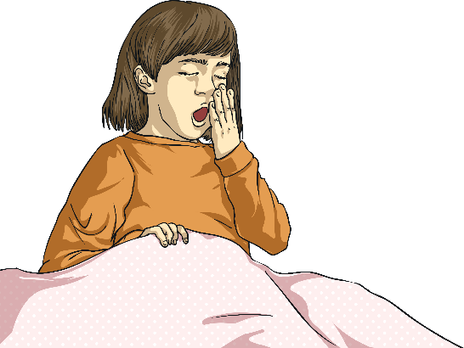

Introduction
Commas are used between clauses to break up long sentences. They are used before words like ‘and’, ‘but’, ‘so’, and ‘for’.
I was feeling really tired, so I got up and went to bed.
Can you break up this sentence using a comma?
,
Yesterday I built a lego model but today I enjoyed a film.

Slide 9

Introduction
Commas can be used before speech marks begin.
Tommy shouted, “Has anyone seen my glasses?”
Commas are also used after fronted adverbials.
Fortunately, the plate I dropped didn’t break.

Slide 10

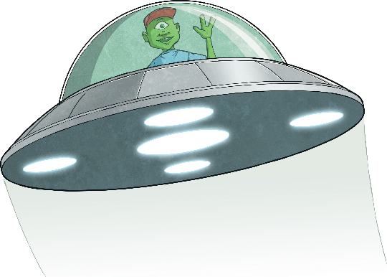
Activity
Complete the ‘Fix my Sentence’ activity.
For the first 5 questions, you will need to repair the incorrect sentences with commas.
After that, you will need to write or complete the sentences, remembering to use commas correctly.

Slide 11
Plenary
Can you explain why each of these commas are in the sentences:
On Saturday, I’m going to read my new book.
Michael said, “I’m not tired.”
You can have your potatoes boiled, steamed, mashed or roasted.
I like playing Cluedo, but I prefer to play Pictionary.

