Slide 1


Slide 2
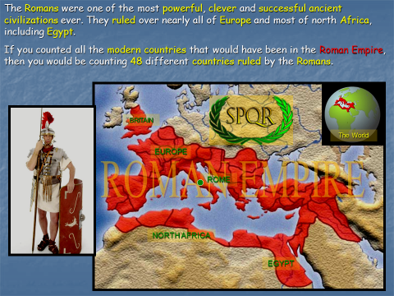

Slide 3
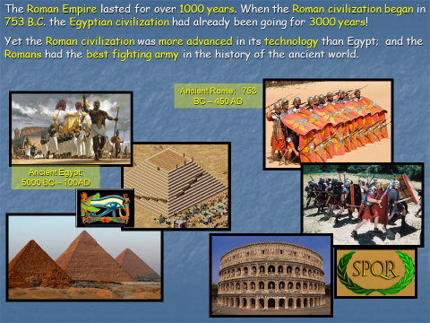

Slide 4
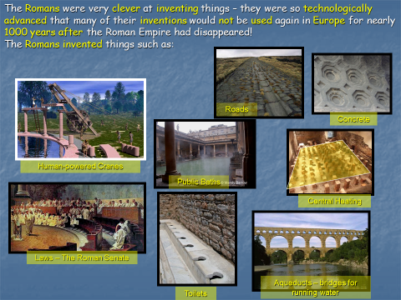

Slide 5
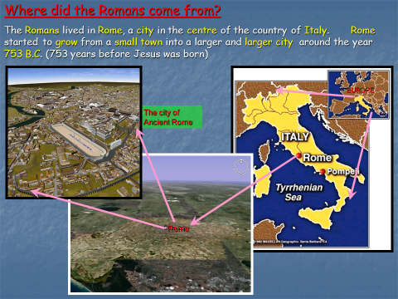

Slide 6


Slide 7


Slide 8
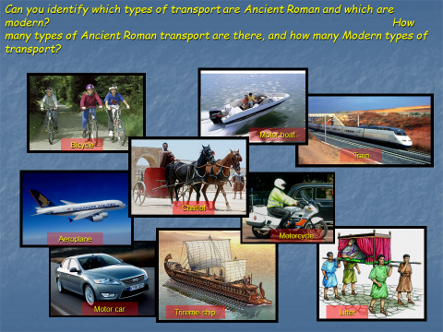

Slide 9


Slide 10
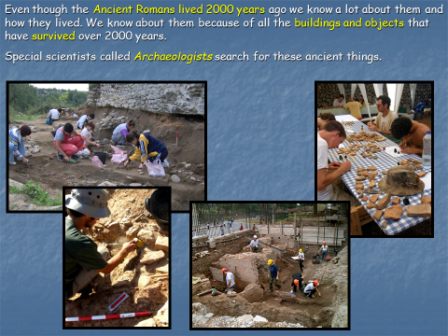

Slide 11
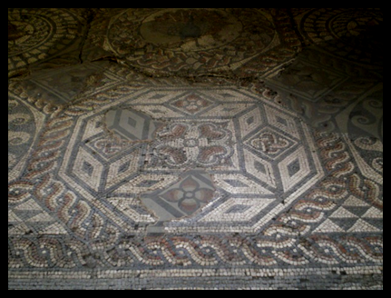
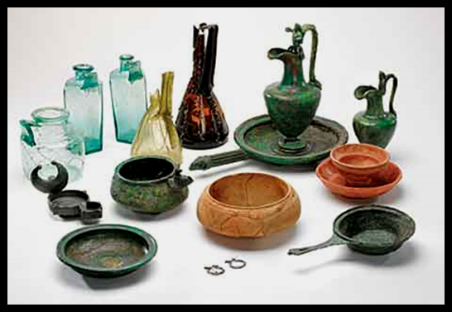
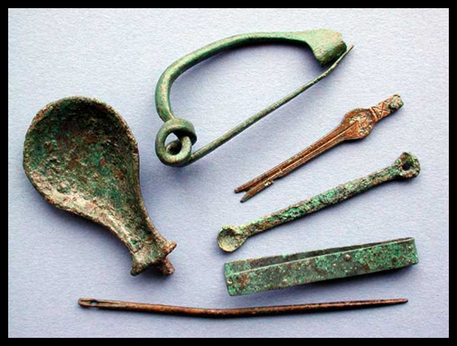
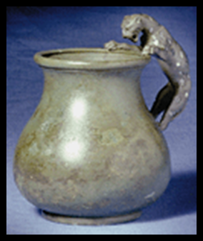
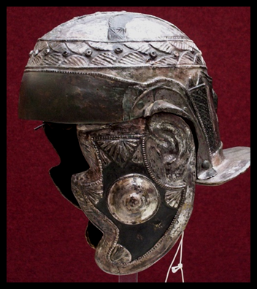
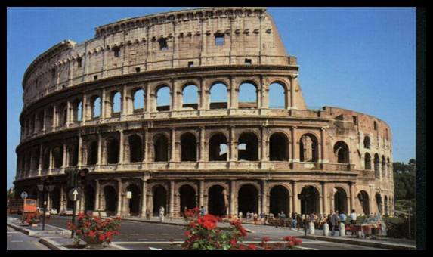
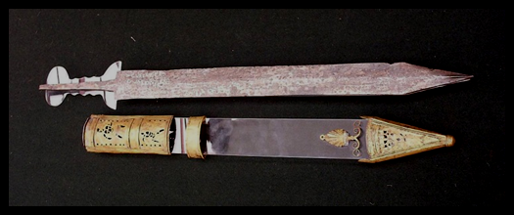
These are a few of the many thousands of Roman objects that archaeologists have discovered buried in the earth for over 2000 years. Can you tell what of any them are, or what they might be used for?
Click to reveal images
Mosaic tile floor
Glass and pottery jars and bowls
Decorative brooches
Pottery drinking cup
Colosseum arena in Rome
Soldier’s short sword and scabbard
Soldier’s helmet

